Slide 1
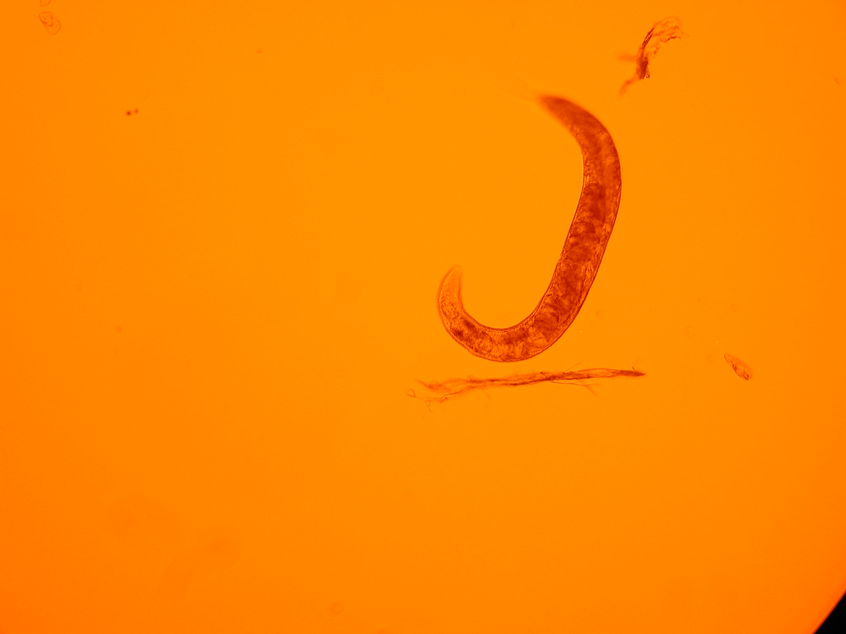
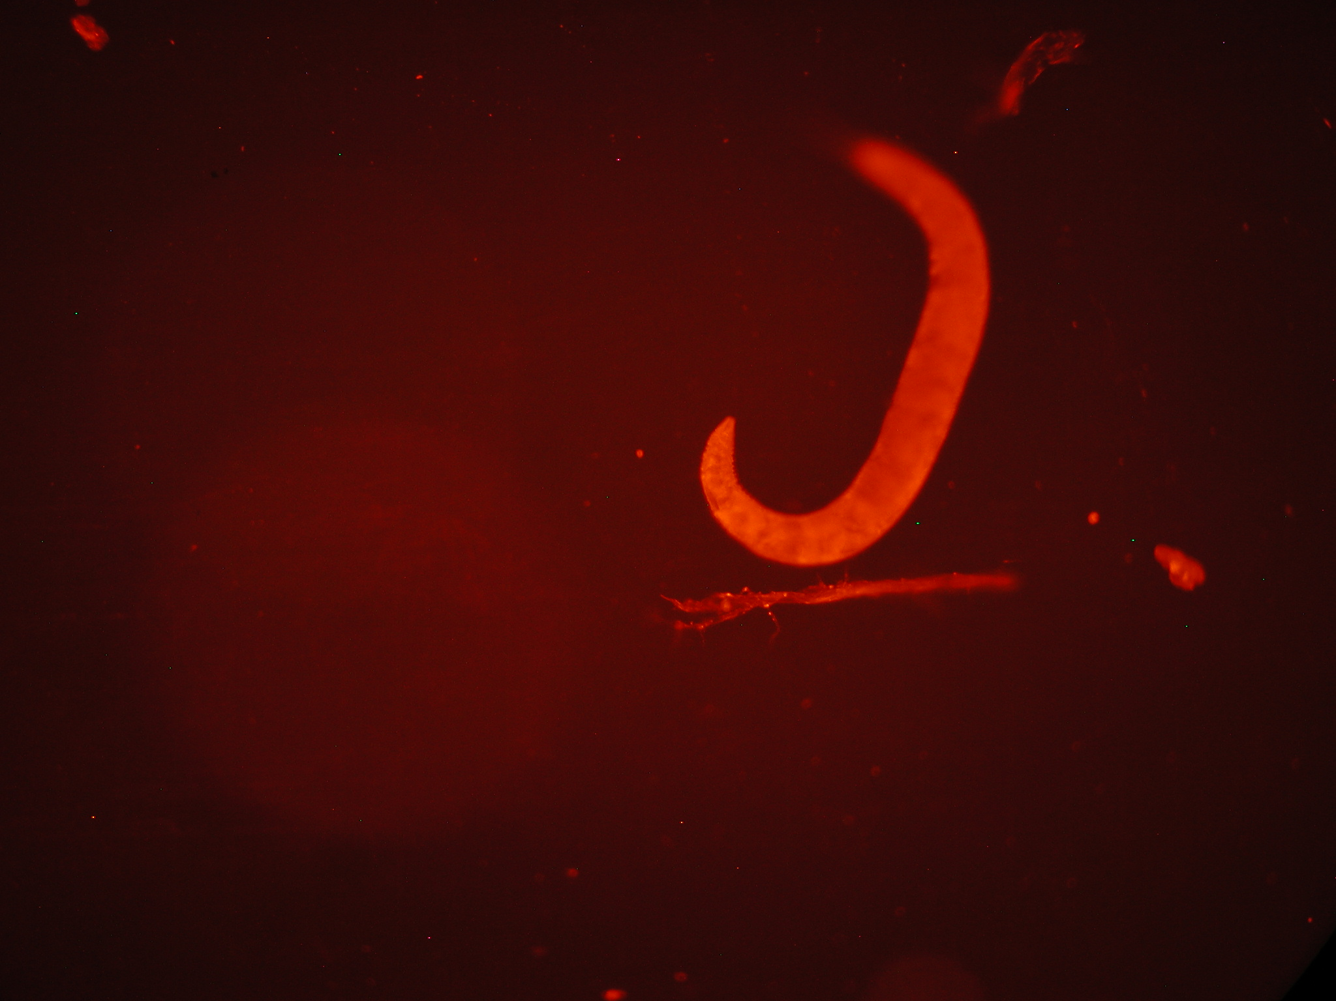
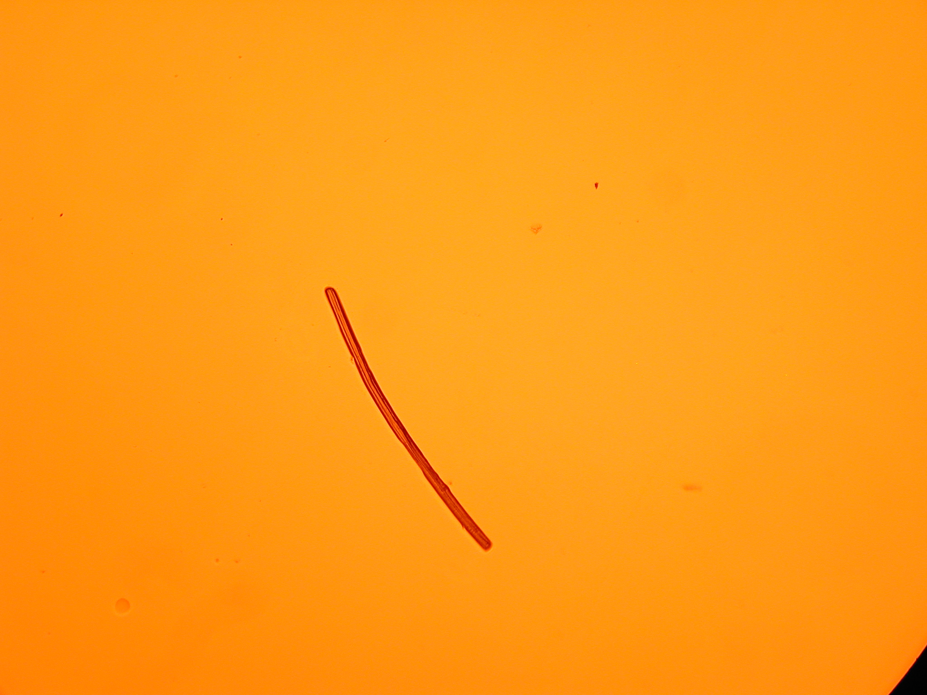

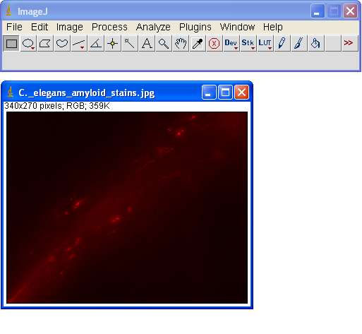
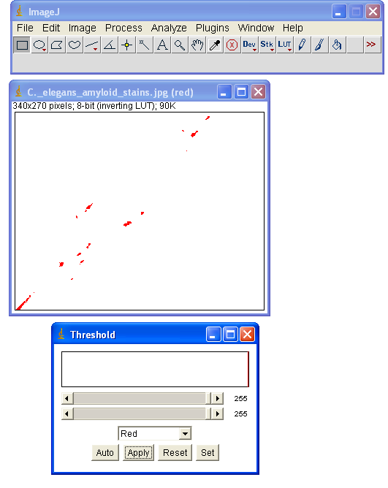
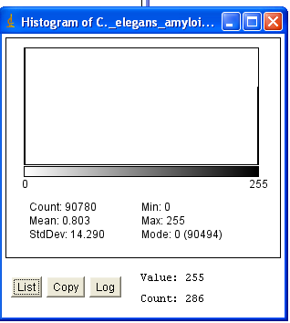
Effect of Melatonin on the Rate of Amyloid-Beta Aggregation in the Caenorhabditis elegans Strain CL4176
Olivia Jeffers and Rathna Ramamurthi
Abstract
Amyloid-beta (A-β) aggregation is one of the suspected causes of the debilitating, neurodegenerative disease Alzheimer’s. Melatonin, a potent antioxidant and naturally-occurring neurohormone that regulates the sleep-wake cycle, is known to decrease oxidative stress and possibly A-β aggregation. The C. elegans strains CL4176 and CL2006 are genetically engineered to express the human A-β peptide. We used the amyloid-specific dye NIAD-4 from Nomadics, Inc. to stain and image the CL4176 C. elegans.
Results
Our results with the CL4176 and NIAD-4 yielded no difference between the CL4176 and the Wildtype strain. We also found that many molds and particulates fluoresced as well.
Non-fluorescent view of CL4176 vs. Fluorescence
Materials and Methods
We used the C. elegans strain CL4176 from the CGC at the University of Minnesota. The CL4176 produce cytoplasmic (within the cell) A-β peptides upon a temperature upshift, while the CL2006 produce extracellular, hydrophobic A-β plaques within a few hours of hatching.
The NIAD-4 was graciously donated by Randall Morse from Nomadics, Inc.
The 0, 4, and 8 picomolar concentration of melatonin were mixed into the E. coli food source and the C. elegans were stained with a 10 μM NIAD-4 and imaged with the Olympus microscope and camera. The images were analyzed with ImageJ.
A rod shaped particulate that fluoresces very brightly.
Discussion
During communication with Dr. Maria Florez-McClure, we found that she suspected that the cytoplasmic A-β aggregation in CL4176 does not bind to NIAD-4. The hydrophobic, plaque A-β aggregation in CL2006, however, did bind to NIAD-4, producing the sample image on the bottom left of the poster.
The experiment should be repeated using the CL2006 strain of C. elegans. We used CL4176 because we could control the start time of aggregation. However, CL2006 may still be used as long as the initial value, which may not be zero, of aggregation is factored into the calculations.
Conclusion
The experiment ultimately did not answer the hypothesis, however, it did prove that NIAD-4 does not bind to the cytoplasmic X plaques in CL4176. The experiment should be continued with CL2006.
Future research can look at whether or not melatonin has an effect on the rate of accumulation when introduced to a group of C. elegans that already have X plaques or if melatonin decreases the size of pre-existing plaques.
If our hypothesis can be proven, an early regimen of melatonin could be used to slow the rate of X aggregation and possibly delay the onset of Alzheimer’s disease.
Acknowledgements
Thank you to Mr. Fred Lampazzi and Mr. Larry Gaudreault for letting us use their fluorescent microscope, to Mr. Behling for assisting us in creating a C. elegans house, to Ms. Diane Hurd for all of her assistance, troubleshooting, and generosity with the fluorescent microscope, to Mr. Randall Morse for his donation of the NIAD-4, to Dr. Anne Rougvie from the CGC for the waiver for the CL4176, and to Dr. Chris Link and Dr. Maria Florez-McClure with all the help with the C. elegans.
A sample of the ImageJ analysis using a sample image sent by Dr. Christopher Link and Dr. Maria Florez-McClure. The original picture is on the left, the analyzed picture is on the right, where the brightest spots representing A-β aggregation were selected out and, on the bottom left, a histogram was created.

